Slide 1

Thato B Mothibi
IWA19 Final Capstone Presentation

Slide 2
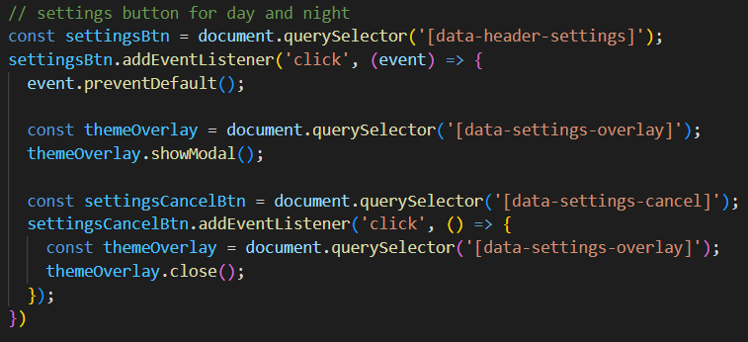
Theme button modal:Open and Close
Given code:
The one I coded:
Added:
* The document.querySelector method to return the specified attribute.
* Added an event listener to the theme button to enable the overlay to display when the button is clicked.

Slide 3
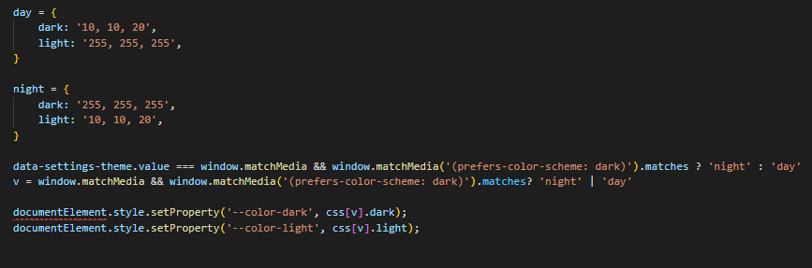
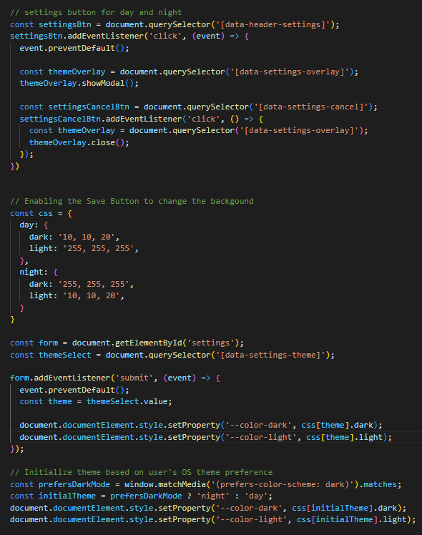
Given Code:
The one I coded:
Code Block for theme change, I’ve added:
I’ve declared a variable that holds objects of day and night with its properties.
Added an event listener to the save button so that when the save button is clicked the selected changes should be applied.
Changes the theme by using the matchMedia method which checks if the document matches a particular media query and if true the system changes the mode as detected.

Slide 4
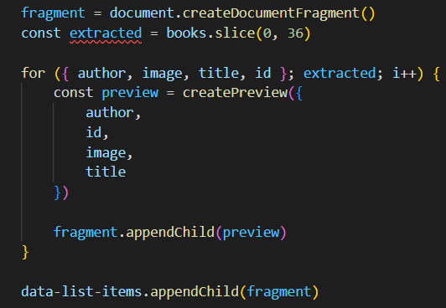
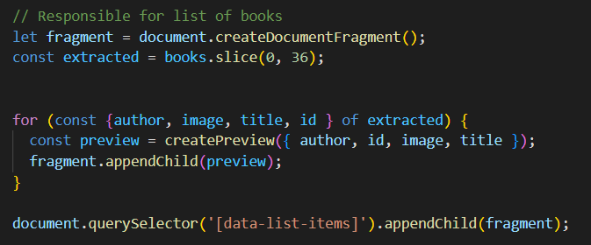
Changes I’ve made:
Given Code:
Added:
I’ve declared fragment and and removed another variable of extracted since it was declared more than once.
Added Const and of before extracted to show that I’m destructuring properties on an object variable of extracted.
Overall, this loop firstly destructures properties of an object extracted, then uses a createPreview function to preview data of this specified values. There after it appends the created preview to the fragment.
The one I coded:

Slide 5
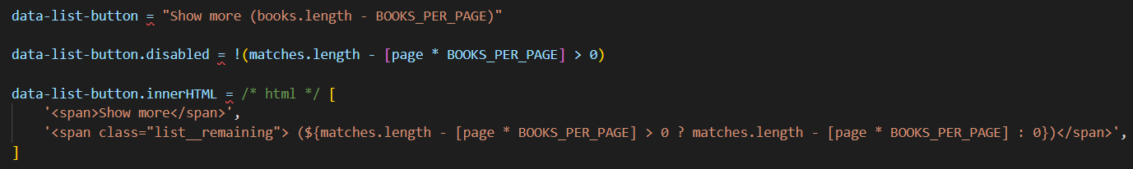
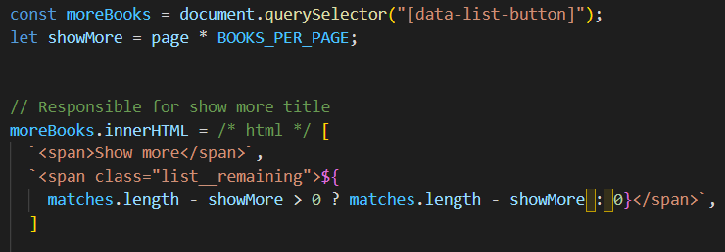
Changes I’ve made:
Given Code:
I’ve reassembled and created variables that holds the specified attribute and the specified values to be needed.
Called the declared variable to set the markup contained within the declared element.
They had used single quotes, so I removed them and used backticks as a way to interpolate the strings and values to be displayed.
The one I coded:

Slide 6
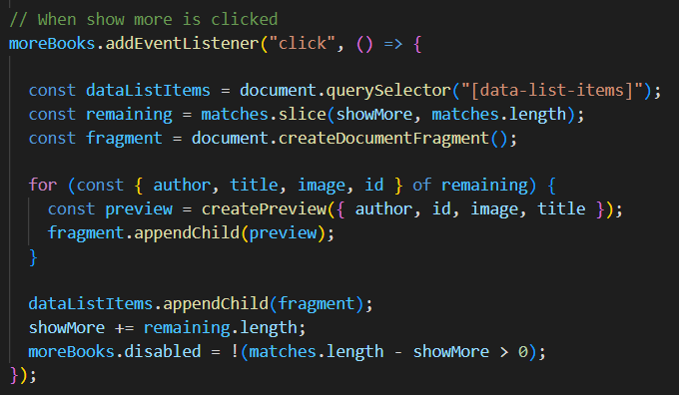
Changes I’ve made:
Given Code:
The one I coded:
Since I’ve already declared a variable that holds the attribute of list button, I called it to add an event listener to it.
I therefore declared variables to be used in a loop.
It destructures properties of an object remaining to create variables. Therefore the createPreview function, creates a preview of the data stored in this values of an object. Thereafter it appends the preview to the fragment. And again appends the fragment to the list attribute.
It then calculates the total number of items to be displayed. It then checks if there’s any available item to be displayed. If they’ve all been displayed, show more button is displayed.

Slide 7
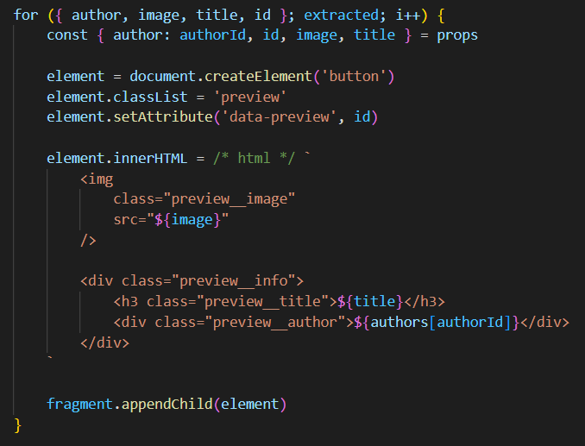
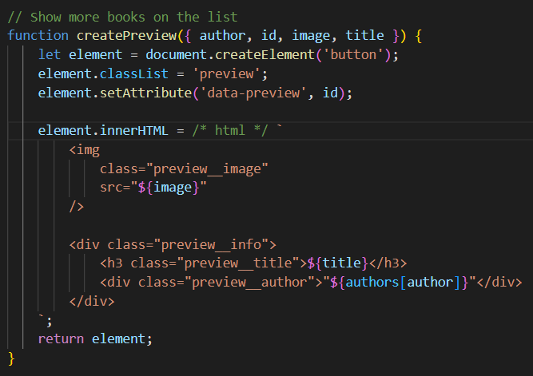
Changes I’ve made:
Given Code:
I’ve created a createPreview function, then used let to declare variable element which is used to to create an HTML element called button. And set it class name to Preview and adds a data preview attribute with the value to id from the input object.
It then creates a new HTML structure with an image, title and author using the values from the input object
Therefore it returns the new button element with the added HTML structure as a child element, creating a preview of the content using the input object's data.
The one I coded:

Slide 8
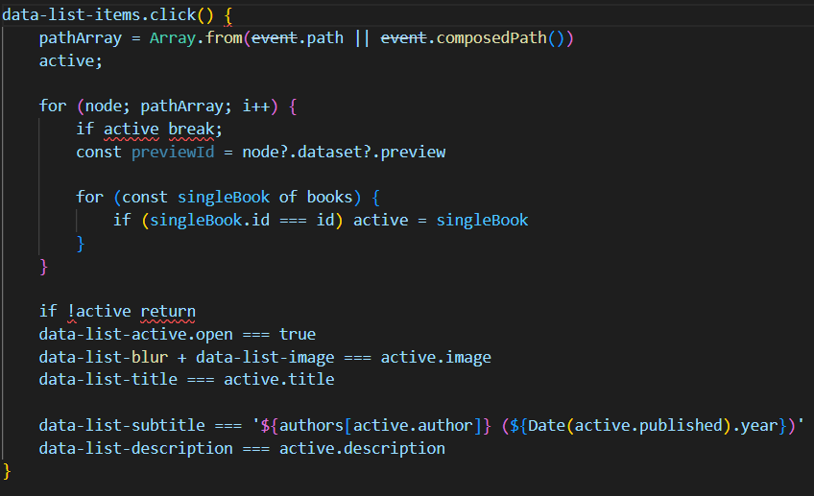
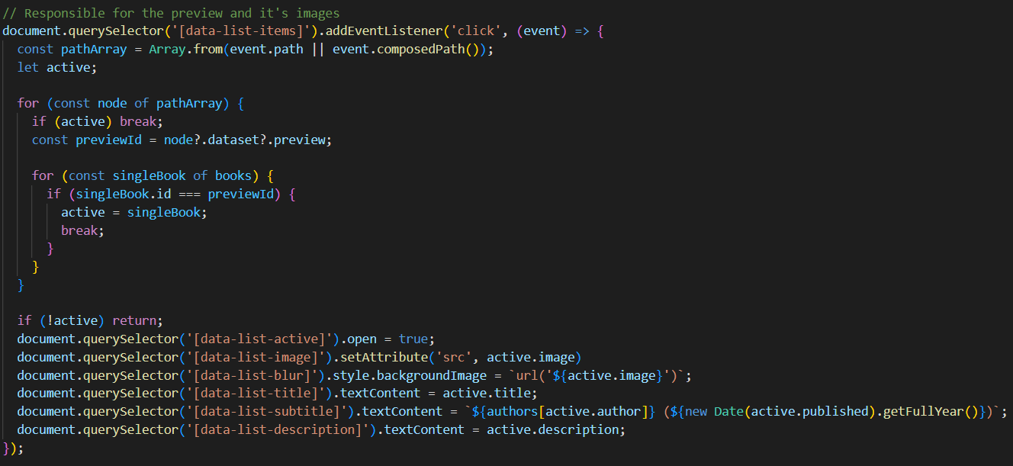
Changes I’ve made:
Given Code:
1.I’ve added an event listener to the mentioned element and declared few variables.
Added const to the for loop. Added active on brackets.
Took out id and put previewId instead and added curly brackets and added break.
Used document.querySelector method and used the right operators.
Overall, what this loop does is that If the clicked element has a data-preview attribute, the code loops through an array of books and looks for the book with an id property that matches the data-preview value. Once it finds a match, it sets the active variable to the book object.
If an active book object is found, it updates the information to be displayed about the books.
The one I coded:

Slide 9
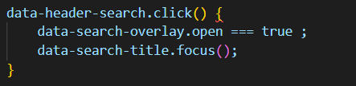
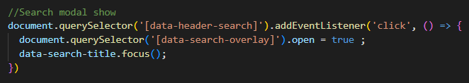
Changes I’ve made:
Given Code:
Used a document.querySelector method to the given attributes and added an event listener.
Overall what this does is that, when this button is clicked, it’s modal should display and immediately when it opens it should set it’s focus to the title.
The one I coded:

Slide 10
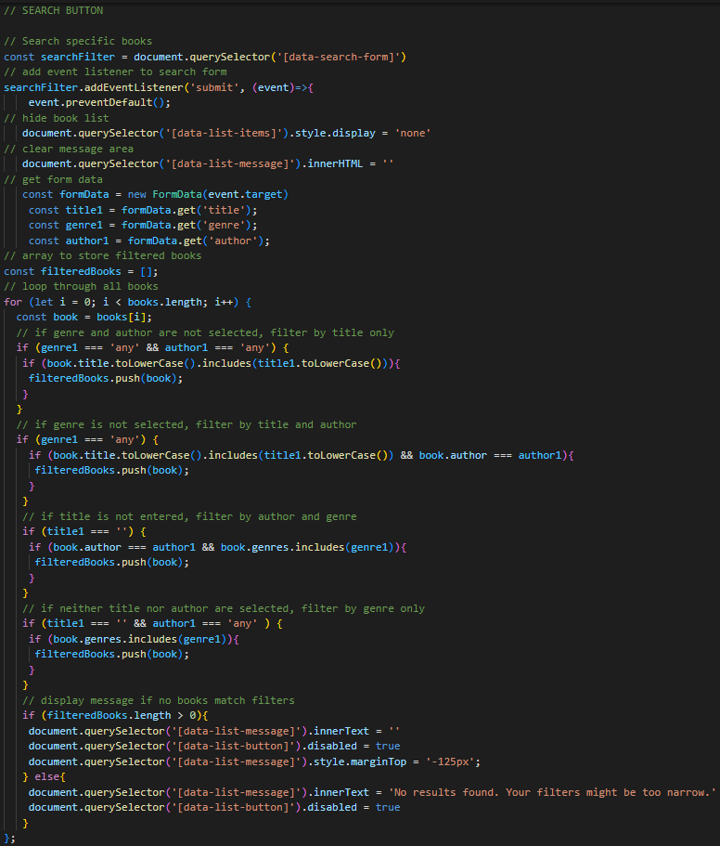
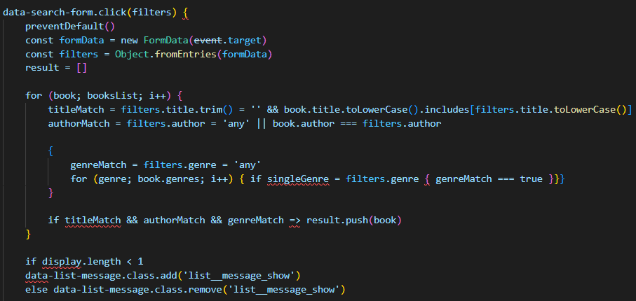
Changes I made:
The one I coded:
Given Code:
1. Used a document.querySelector method to the given attributes and I’ve added an event listener to the button.
2. The for loop is filtering a list of books based on user-selected criteria such as title, author, and genre. It loops through each book and checks whether the user has selected a particular genre, author, or title, and filters the books accordingly. If there are no matches found for the selected filters, a message is displayed stating that no results have been found, otherwise, the filtered books are displayed.

Slide 11
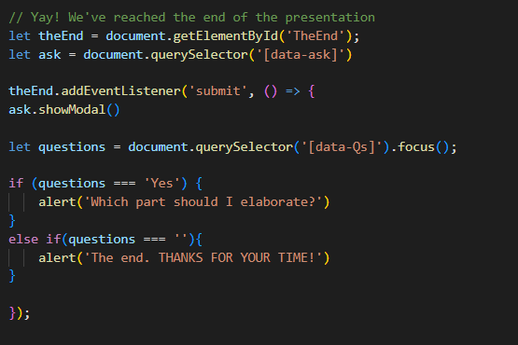
I’m Done:

